Slide 1
Airbnb Analysis by Diplodocus Team Pronounced: duh·plaa·duh·kuhs
Alfonso Camero
KC Oh
Marie Prosper

Slide 2
Breakdown of Tasks
Alfonso Camero
Project leader, Bar graphs
KC Oh
Bar Graphs
Marie Prosper
Project coordinator, proposal, jointplot plot(not used)

Slide 3
Project Description
Since its inception in 2008, Airbnb has disrupted the traditional hospitality industry as more travelers decide to use Airbnb as their primary means of accommodation. Airbnb offers travelers a more unique and personalized way of accommodation and experience.
This dataset has one file- airbnb_data.csv and opendatasoft
This dataset contain information on Airbnb listing across the United States and we tried to analyze the data.

Slide 4
Project Questions
What are we trying to solve? Independent/Dependent variables
How does population affect the variables included in the dataset?
Are there any clear relationships between some of the variables?
Dataset
Csv file: airbnb_data.csv
id, name, host_id, host_name, neighbourhood_group, neighbourhood, latitude, longitude, room_type price, minimum_nights, number_of_reviews, last_review, reviews_per_month calculated_host_listings_count availability_365, city
url = f'http://public.opendatasoft.com/api/records/1.0/search/?dataset=cities-and-towns-of-the-united-states%40public&q={city}&facet=name&facet=state&refine.name={City}&refine.state={state}'

Slide 5
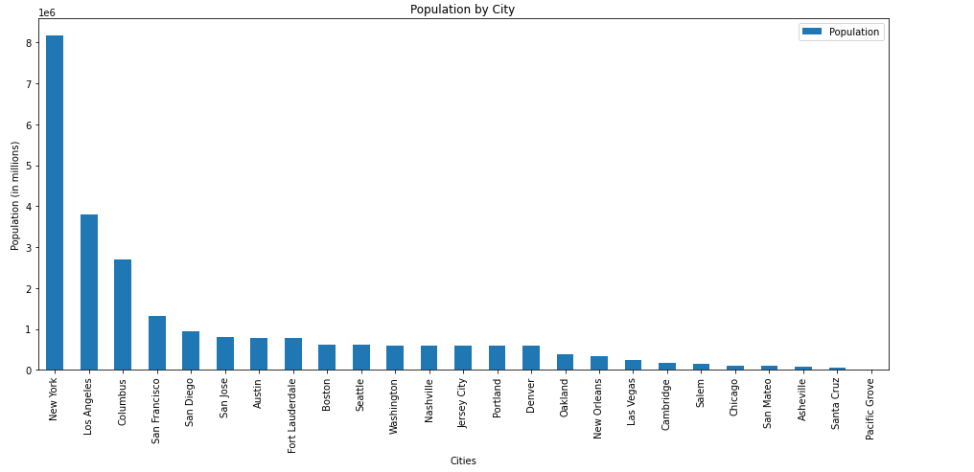
Population by City

Slide 6
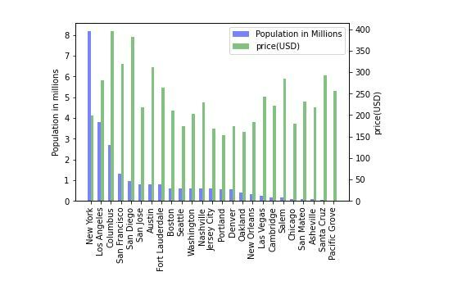
Population by City vs. Price per Night

Slide 7
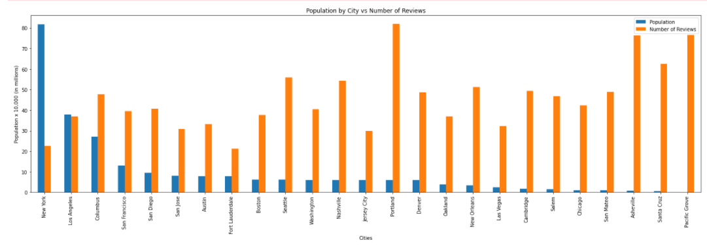
Population by City vs. Number of Reviews

Slide 8
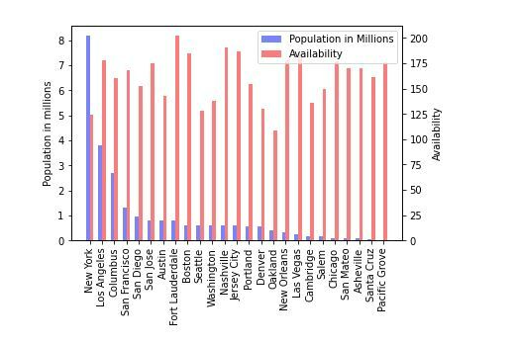
Population by City vs. Availability

Slide 9
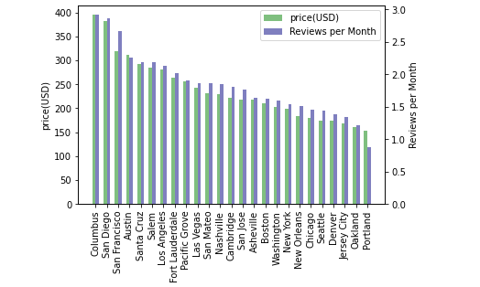
Price per Night vs. Number of Reviews

Slide 10
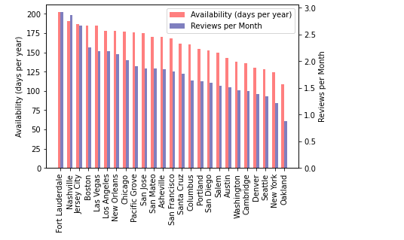
Availability (days per year) vs. Reviews per Month

Slide 11
Question?

